Slide 1
RPG ARENA Project
Specialized study project

Slide 2
AR integration with unity AR foundation
The game incorporates Augmented Reality (AR) features using Unity's AR Foundation and Google XR Code. This integration allows the game to project 3D game elements into the real world, creating an immersive and interactive experience for players.
Plane Detection: AR Foundation provides plane detection capabilities, allowing the game to identify flat surfaces in the real world where game elements can be placed.
Light Estimation: AR Foundation can estimate the lighting conditions of the real world, enabling more realistic rendering of virtual objects.
Session Management: Manages AR sessions, handling the lifecycle and state transitions of AR experiences.

Slide 3
Google xr code
Google XR Code extends the capabilities of ARCore, providing additional features and functionalities for AR development.
ARCore Extensions: Enhanced features and tools that improve ARCore’s performance and capabilities.
Cloud Anchors: Allows sharing and persistence of AR experiences across devices, enabling multiplayer AR interactions.
1. Setup: Integrate Google XR Code with the Unity project.
2. Extended Tracking: Use ARCore extensions for improved tracking and stability of virtual objects.

Slide 4
Gameplay integration
Endless Survival Mode
The AR integration introduces an endless survival mode where players must continuously fight against waves of enemies. The game leverages AR plane detection to place enemies and obstacles in the real world, creating an immersive and dynamic gameplay experience.

Slide 5
Project Description
You are a character with a rifle and limited ammo. Your objective is to clear the level without dying. Monsters will start chasing you when you are 8 tiles close to them. You can play this game using two strategies:
Kill all enemies, but there are limited bullets.
2. Play stealthily and avoid as many enemies as possible.

Slide 6
Gameplay outline
The player navigates through various levels, each filled with monsters and obstacles. The player must manage their limited resources (ammo and health) and make strategic decisions on whether to engage or avoid enemies. The game ends when the player either clears the level or dies.

Slide 7
Mechanics
1. Character Movement Controls: W/A/S/D or Arrow Keys: Move forward, left, backward, and right. Mouse: Control camera and aim and shoot.
2. Aiming and Shooting Aim: The player uses the mouse to aim their rifle. Shoot: Left mouse button to shoot. Each shot reduces the bullet count.
3. Health System Health Bar: Displayed on the UI to show the player’s health. Damage: Health decreases when attacked by monsters. The game ends when health reaches zero.
4. Stealth Mechanics Detection Radius: Monsters.

Slide 8
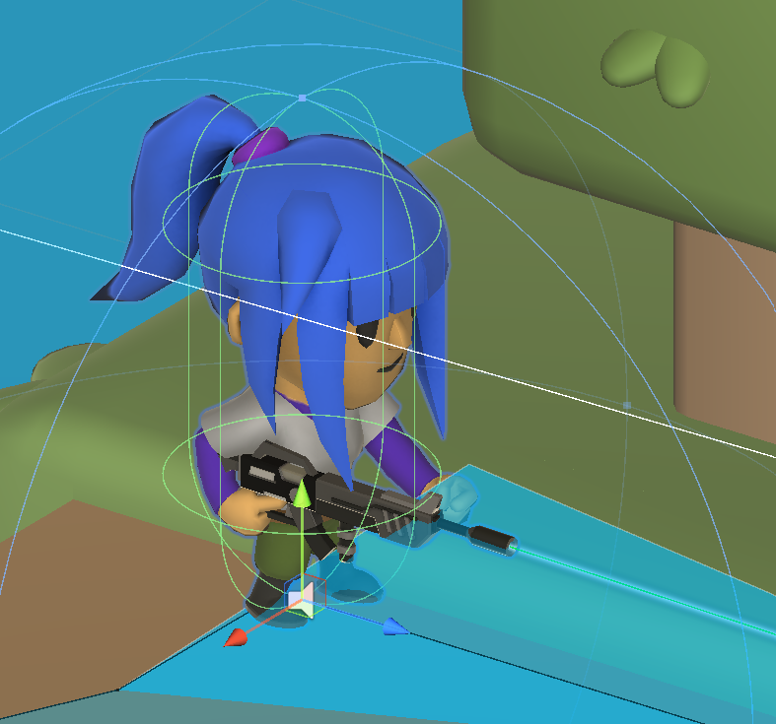
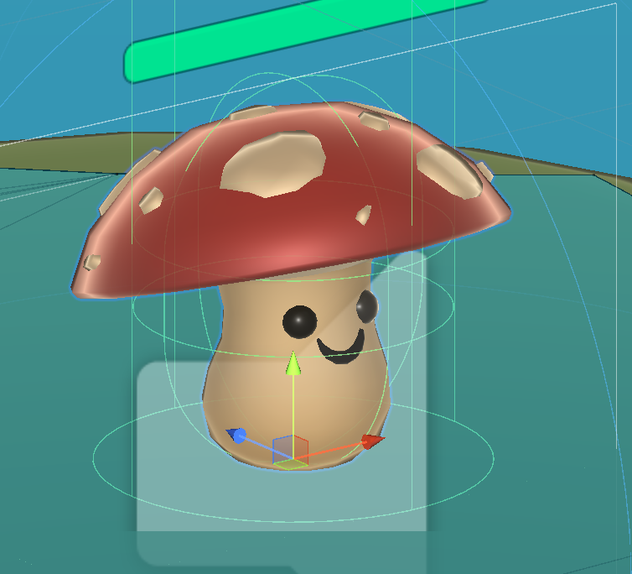
Characters
Player character: Player character that user control to progress through the levels.
2. Enemy characters: These are the characters that will attack the player to kill when you enter into the particular radius of an enemy area.

Slide 9
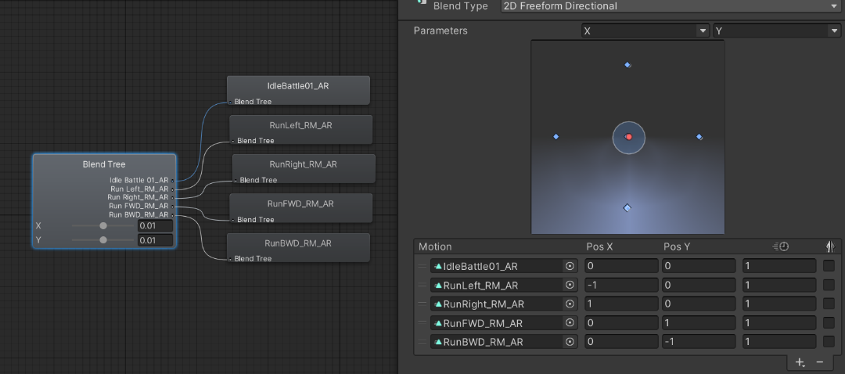
Key Features
Animation Controllers –

Slide 10
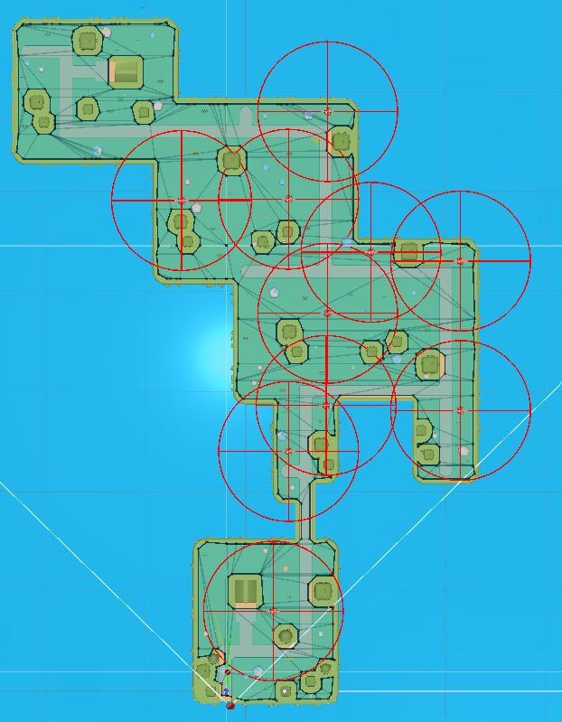
Key features
2. Navigation Mesh (NavMesh) for AI pathfinding.

Slide 11
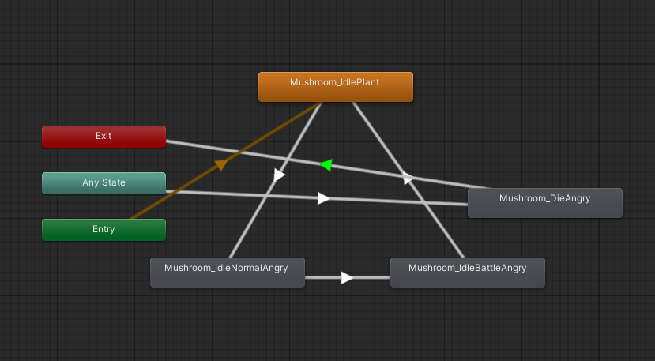
Key features
2.3rd Person camera and controller.

Slide 12
Art and graphics
Environment: Detailed 3D environments with interactive elements
Characters: High-quality 3D models with smooth animations
Effects: Particle effects for smoke, sandbox
UI: unity sample UI pack

